Slide 1

Team 5 - Smart Building Session 2
Advisor : Yoav Freund

Slide 2
Team and Roles
Rajesh – Project Lead, Design and Development
Manoj – Treasurer, Design, Development and Visualization
Karuna – Data Exploration, Design and Development

Slide 3


Slide 4
The Challenge
Modern large office buildings have centralized climate and energy control.
Each room in these buildings is deployed with a variety of digital sensors.
The readings from all of these sensors form large data streams that are monitored and logged.
Currently, sensors data stream is being used to alert maintenance staff in case of problems.
Current sensor data is not predicting malfunctions.

Slide 5
Question Formulation
Can we Analyze and Identify Patterns from the data logged from few buildings in UCSD?
Can we Create a model for each of these rooms?
Based on these models
Can we accurately detect anomalies within the room?
Considering Sensors are accurately logging the values
Can we Identify malfunctioning sensors?
Based on Atypical Values of Sensor by Outlier detection

Slide 6
Tools
Development
Python
PySpark on DataBricks
Storage
AWS S3
Visualization
Matplotlib
bokeh

Slide 7
Datasets: Selection, Collection and Management
Data Available in Amazon AWS S3 instance
Reduce the frequency of Capture of Signals
Original Data – json
Compressed Data - csv
Import reduced data to Databricks Tables

Slide 8
Data Preparation
Format Date and Time
Weekday and weekend determination
Data separation based on the room
Table based on each room
Normalize different signals(for example)
Actual Cooling setpoint
Actual Heating setpoint
Damper Command
Cooling Max flow

Slide 9
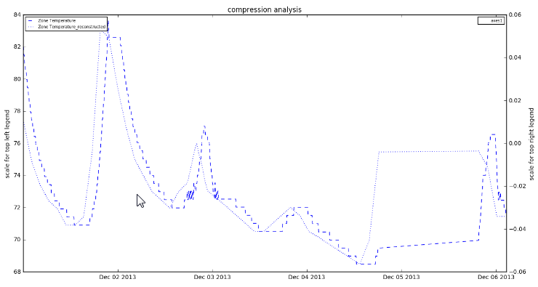
Exploratory Analysis
Distribution of different types of Sensors and its signals
Piecewise Linear Compression Analysis

Slide 10
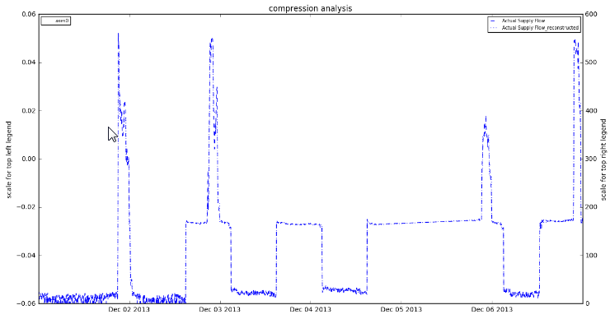
Exploratory Analysis - contd
Piecewise Constant Compression Analysis

Slide 11
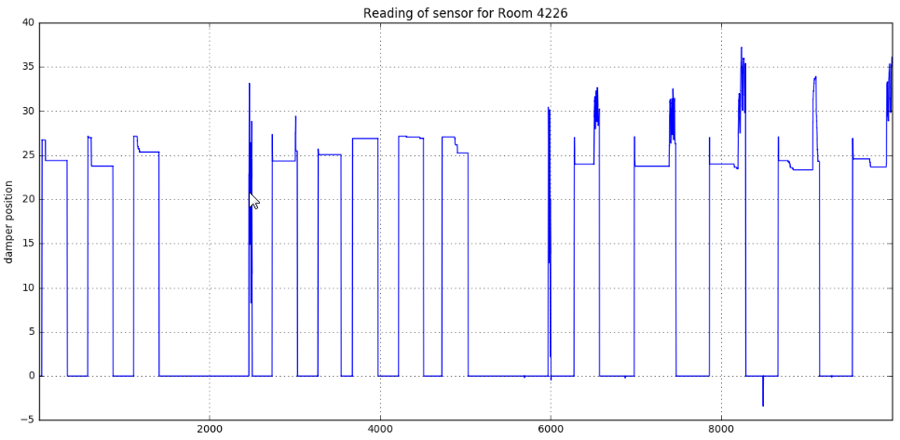
Progress to Date and Preliminary Results
Sensor data from a specific room for a signal.

Slide 12
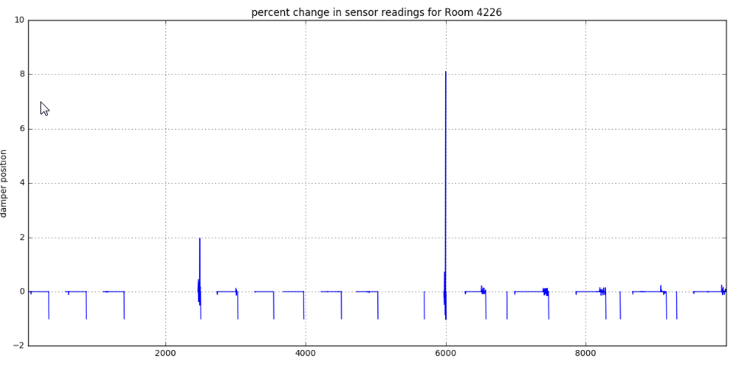
Progress to Date and Preliminary Results - contd
Percentage change in Signal for a room

Slide 13
Learned
Work on Sample data before working on entire data.
Importance of compression
Concept of MDL(Minimal Description Length)
Run length Encoding

Slide 14
Next Steps and Timeline
Plots for specific rooms and multiple sensors across the time.

Slide 15
Session 2 mar 3rd 2017

Slide 16
Sampling & exploratory analysis
Spark & DataBricks Activities
Queries to
Identify the distribution of various signals in the entire data
Identify the distribution of signals for different rooms
Identify the distribution of signals for a given room for All Signals Available
Identify the distribution of signals for a given room for Specific set of signals
Cool set point
Heat set point
Damper position
Supply flow
zone termperature.
Identify the time range for a given room when All of the specific signals were available
Identify data gaps in the final extraction
Room identified with all 5 signals available RM-1156 for timeperiod Feb 2015 – May

Slide 17
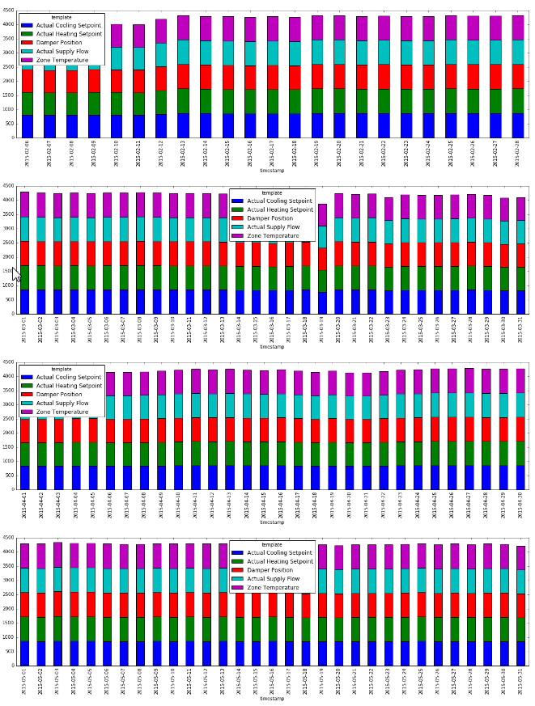
Sampling & exploratory analysis
Identify the time range for a given room when All of the specific signals were available
Identify data gaps in the final extraction
Room identified with all 5 signals available RM-1156 for timeperiod Feb 2015 – May

Slide 18
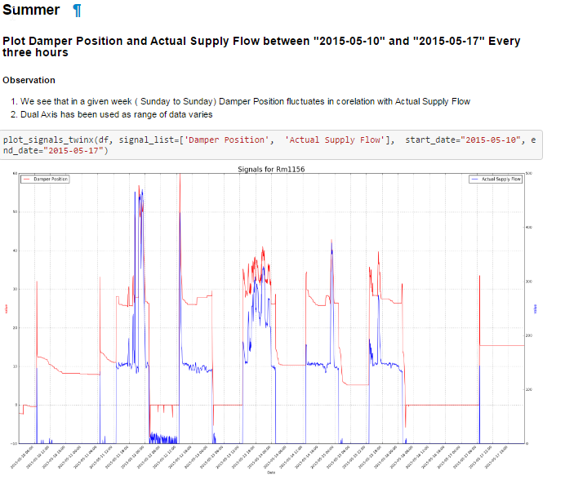
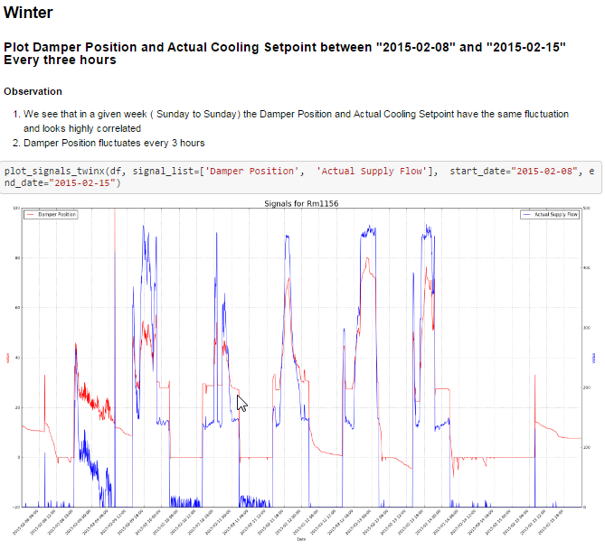
Signal analysis & visualization Summer Vs winter(Rm-1156 feb2015-may2015

Slide 19
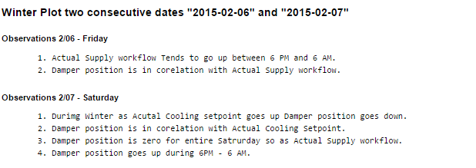
Signal analysis & visualization between weeks

Slide 20
Learned
Started to see the bigger picture
Importance of exploring the health of data
How exploratory Analysis gave insight to choose the concentration of data
Data gaps identified for the signals that are not available

Slide 21
Next Steps
Develop methods to cluster the rooms by signals
Arrive at combination of rooms
Simulate a room with common signals.
Take Advice from Prof to Develop Algorithms for modelling

